Slide 1
Topic 15: Nuclear Physics
15.4 Mass excess and nuclear
binding energy
15.5 Radioactive decay

Slide 2
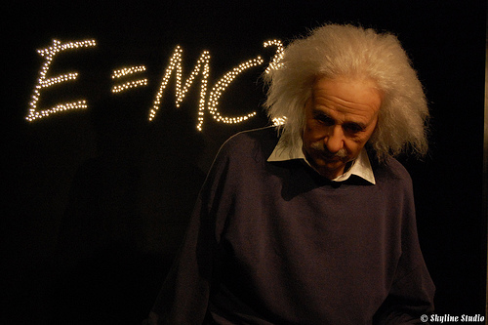
Einstein’s Famous Equation
Mass and Energy are interchangeable!!

Slide 3
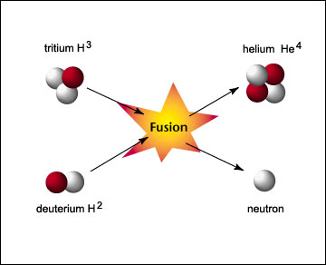
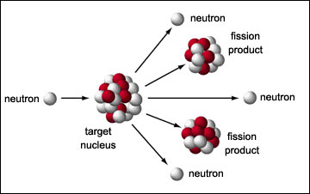
Where & When??
It happens only at the nuclear level
When two nuclei combine (Fusion)
OR When a nucleus breaks up (Fission)

Slide 4
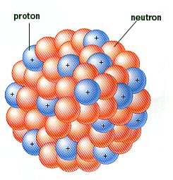
Mass Excess
Nucleus
Proton
Neutron
m_{p}
m_{n}
m_{nucleus}
When protons and neutrons come together to form a nucleus, the mass of the nucleus is less than the sum of the masses of separated protons and neutrons.
This difference in mass is called the mass excess or mass defect of the nucleus.
Mass Excess (Defect)
= Mass of separated protons & neutrons – mass of nucleus
Δm = Zm_{p} + Nm_{p} – m_{nucleus}
Where Z is the number of proton and N the number of neutrons in the nucleus.

Slide 5
Atomic Mass Unit (u)
At nuclear level, the masses of the nuclei and nucleons are so small that the unit kg is too big and clumsy to be used.
Instead the atomic mass unit (u) is used.
One atomic mass unit (1 u) is defined as being equal to one-twelfth the mass of a carbon-12 atom.
1 u = 1.66 × 10⁻²⁷ kg
Using this scale of measurement, to six decimal places, we have
proton mass, m_{p} = 1.007276 u
neutron mass, m_{n} = 1.008665 u
electron mass, m_{e} = 0.000549 u

Slide 6
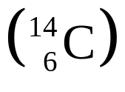
Example 1
Calculate the mass defect for a carbon-14 nucleus .
The measured mass is 14.003240 u.
Calculate also the energy-equivalent of this mass loss in eV.
Solution:
Carbon-14 has 6 protons and 8 neutrons
Mass defect = 6 (1.007276) + 8 (1.008665) –14.003240
= 0.109736 u
E = mc² = [(0.109736 × 1.66 × 10⁻²⁷) × (3.00 ×10⁸)²] / ⁽1.6 ×10⁻¹⁹) = 102 MeV

Slide 7
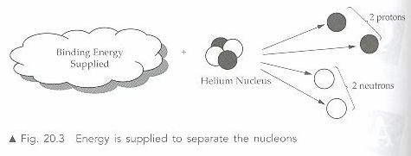
Binding energy
Within the nucleus, there are strong forces which bind the protons and neutrons together.
To completely separate all these nucleons require energy.
This energy is referred to as the binding energy.
Binding energy is defined as the energy required to completely separate the nucleons of a nucleus.
It is the energy equivalent of the mass defect of a nucleus.

Slide 8
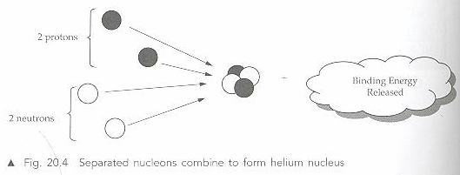
Binding Energy
When separated nucleons combine to form a nucleus, there is a reduction of mass and an equivalent amount of binding energy is released.

Slide 9
Binding Energy Per Nucleon
Binding energy per nucleon is the total binding energy of the nucleus divided by the total number of nucleons.
Binding energy per nucleon
= Binding energy of the nucleus J per nucleon
Nucleon number of the nucleus
It is a measure of the stability of the nucleus.

Slide 10
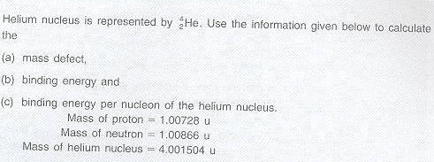
Example 2

Slide 11
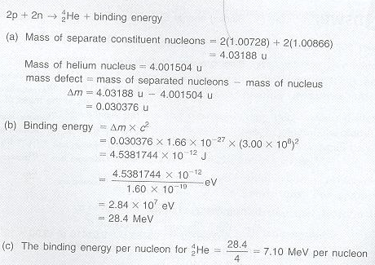
Solution 2

Slide 12
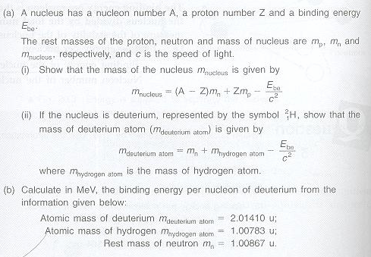
Example 3

Slide 13
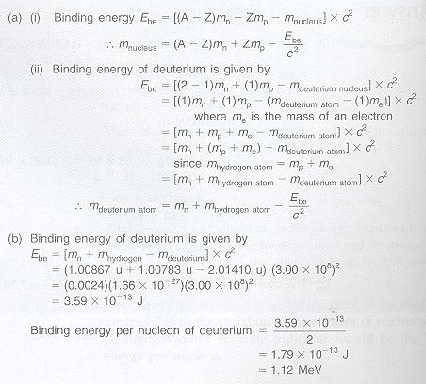
Solution 3

Slide 14
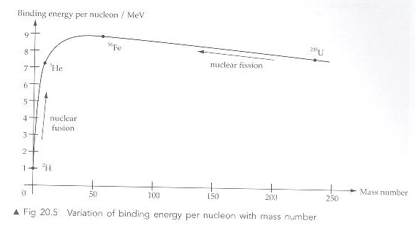

Stability of Nuclei
Most stable region
The nucleus is more stable if it has a higher binding energy per nucleon. It would be more difficult to break up the nucleus as more energy is required to separate the nucleons.
The most stable nuclide can be found at the peak of the curve. It corresponds to the element
It has the greatest mass defect and the highest binding energy per nucleon.

Slide 15
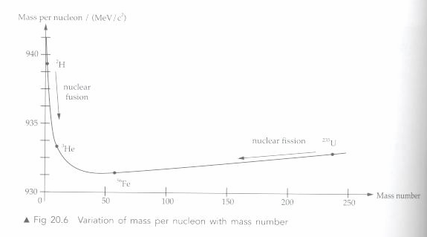
Mass per Nucleon
Mass per nucleon is small when binding energy per nucleon is high.
Elements with very small or very large mass number are unstable.
To attain stability
  Nuclei with low mass numbers may undergo nuclear fusion
  Nuclei with high mass numbers may undergo nuclear fission.

Slide 16
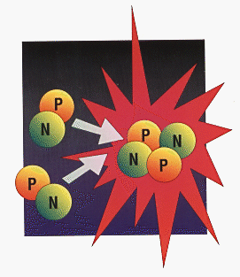

Nuclear Fusion
Nuclei with low mass numbers may undergo nuclear fusion under certain conditions.
In general nuclear fusion is possible as long as the final product has more binding energy per nucleon (i.e. less mass) than the reactants.
The enormous amount of energy generated in the Sun is due to this process.
Energy released in the fusion process is very much greater than energy released in the fission process
An example of nuclear fusion:
  two deuterium atoms fuse together to form helium-3 under extremely high temperature.
  He-3 has a greater binding energy per nucleon and is more stable than deuterium.

Slide 17
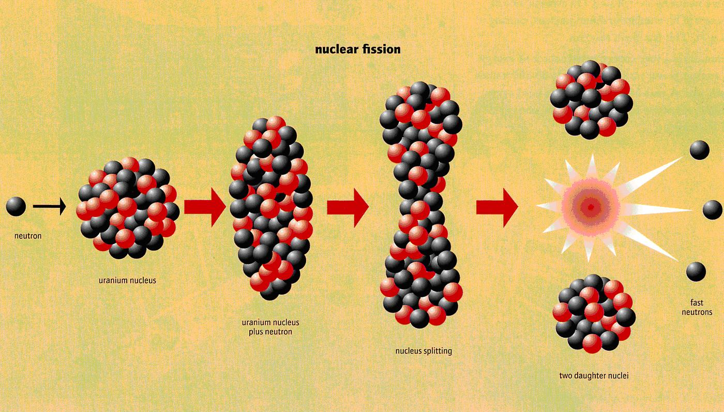
Nuclear Fission
In general, heavier nuclides tend to disintegrate into lighter, more stable nucleus.
Fission fragments have a greater binding energy per nucleon (i.e. less mass per nucleon) than the original nuclide.
Example: Uranium-235 may absorbs a slow thermal neutron and splits into two part, Xenon-144 and Strontium-90.

Slide 18
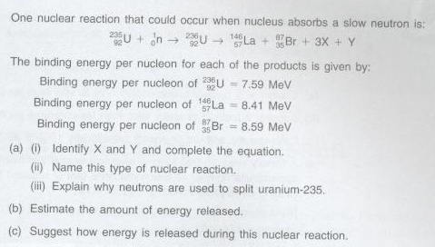
Example 4

Slide 19
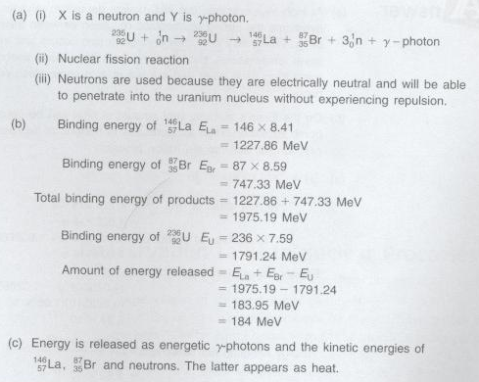
Solution 4

Slide 20
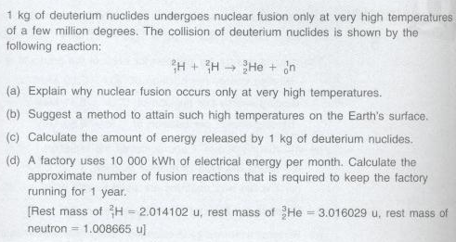
Example 5

Slide 21
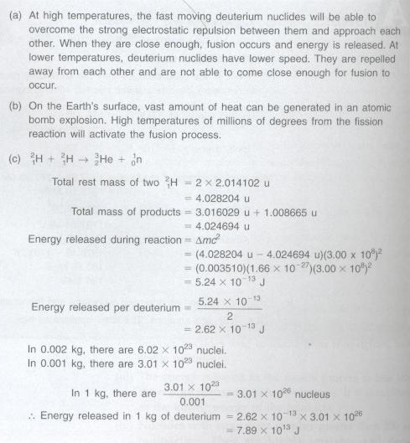
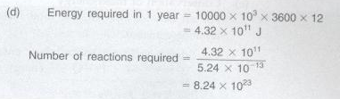
Solution 5

Slide 22
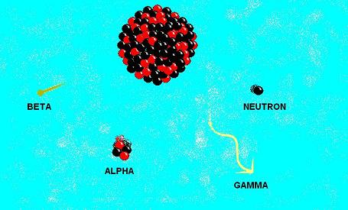
Radioactive Decay
Radioactive decay is the spontaneous and random disintegration of heavy unstable nucleus into more stable products with lower total mass through the emission of radiation such as alpha-particles, beta-particles and gamma-rays.

Slide 23
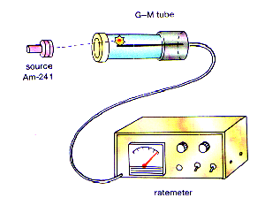
Measuring Radioactivity
Radioactivity decay can be measured with a Geiger-Muller tube connected to a ratemeter. The ratemeter measures the count rate of the radioactive decay
A radiation detector can register a count rate of 20-50 count per second, even in the apparent absence of radioactive materials. This is know as the background count. The radiation comes from low intensity radiation from small quantities of radioisotopes found in the ground, atmosphere and cosmic rays arriving at the surface of the Earth.

Slide 24
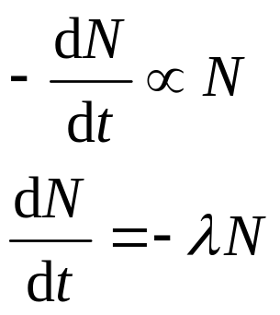
Decay Constant
In a random process, the rate of radioactive decay -dN/dt of a radioactive sample is directly proportional to the number N of radioactive nuclei present. That is,
where
λ = radioactivity decay constant; t = time
The decay constant λ is the fraction of the total number of atoms that decay per unit time.
Its S.I. unit is s⁻¹

Slide 25
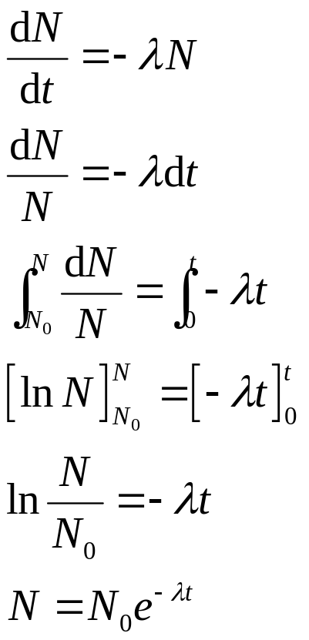
Decay Constant
The radioactive law dN/dt = −λN can be rewritten and integrated as follows:
In general x = x₀ e^{-λt}
where x could represent
(a) activity A
(b) number of undecayed particles N
(c) count rate C or
(d) mass of undecayed particles m

Slide 26
Activity
The activity A of a radioactive source is the number of disintegration it undergoes per unit time.
A = −dN / dt
= −λ N
= −λ N₀ e^{-λt}
= A₀ e^{-λt}
Unit of A is becquerel, Bq
1 Bq = 1 s⁻¹

Slide 27
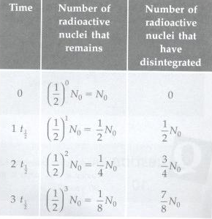
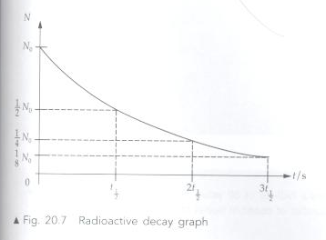
Graphical Representation

Slide 28
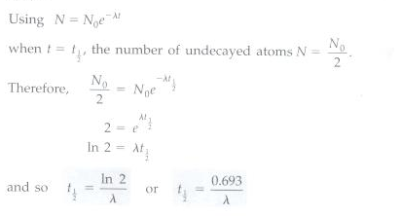
Half Life
The half-life of a radioactive nuclide is the time taken for the number of radioactive nuclide to disintegrate to half its initial value.

Slide 29
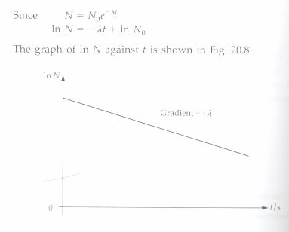
Graph of lnN against t

Slide 30
Half Life of Some Materials
uranium = 4500 million years
radium = 1600 years
polonium = 138 days
radioactive lead = 27 minutes
radon = 1 minute

Slide 31

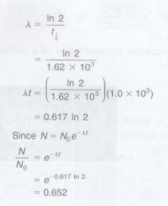
Example 6
Solution

Slide 32

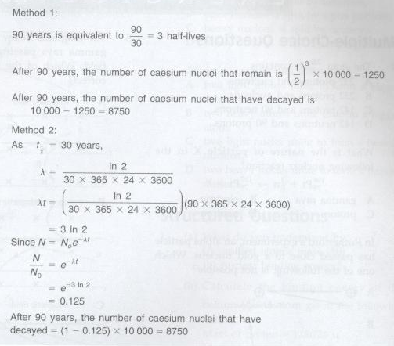
Example 7

Slide 33
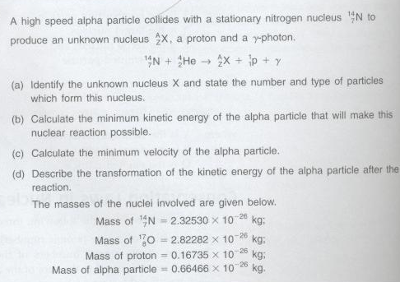
Example 8

Slide 34
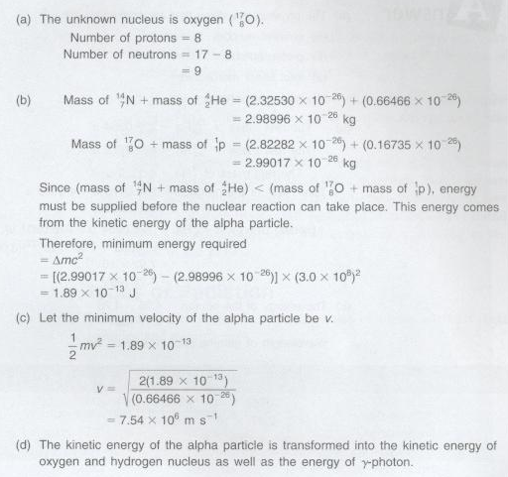
Solution 8

Slide 35
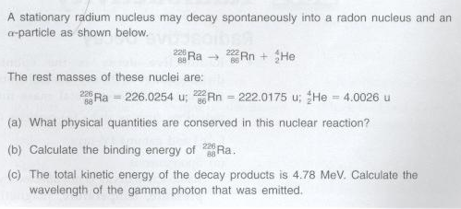
Example 9

Slide 36
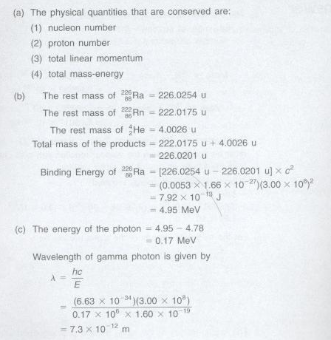
Solution 9

Slide 37
The End

